Slide 1
Example questions 8BB020 Answers

Slide 2


Slide 3
Linear & logistic regression
Key differences logistic & linear regression?
Linear regression predicts a continous output (y), whereas logistic regression predicts the probability a sample is part of a class. So the linear regression output can be between [–∞, ∞] whereas the model output of logistic regression is between [0,1]. The function that maps the input variables to the probability output is the logistic function, hence the name logistic regression.

Slide 4
Linear & logistic regression
Biomedical example?
Linear regression:
In patients with type 2 diabetes we want to minimise the time patients spend with elevated blood glucose levels. We could use a linear regression model to predict the blood glucose level after a meal to see if blood glucose level remain in healthy ranges. As input we can take the nutrients of the meal, age, BMI, if they use insulin yes or no and what dose, etc, and we would train the model on measured blood glucose levels.

Slide 5
Linear & logistic regression
Biomedical example?
Logistic regression:
For early detection of type 2 diabetes we want to be able to predict if someone is possibly at risk of having type 2 diabetes. Our logistic regression model can predict the probability of someone having diabetes on the basis of age, BMI, smoking status, family history, etc. We would then train our model on these demographics and their diabetes status.

Slide 6
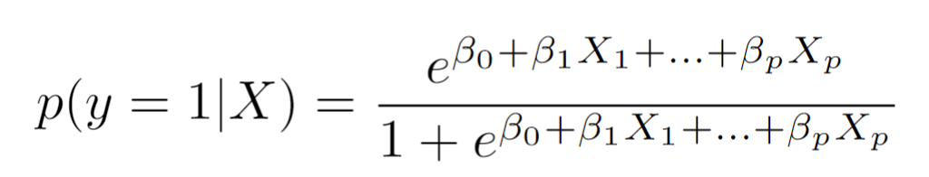
Linear & logistic regression
Logistic regression
Probability that the sample is part of class 1 given datapoint X.
This is the linear prediction model, these beta's are the model parameters that we train.
[0,1]

Slide 7
Regularization in linear models
Difference between Lasso (L1) and Ridge (L2) regularization
The way in which the penalty is calculated. Ridge uses sum of squares and therefore does not force coefficients to exactly zero but makes them all smaller. Lasso on the other hand uses absolute values as a distance measure / penalty thereby forcing some coefficients to be exactly zero.

Slide 8
Regularization in linear models
What does Lasso regression look like for different values of λ?
For a small λ: regularization has little effect.
For a large λ : Coefficients may shrink to exactly zero, effectively removing some features from the model.
For very large λ: all coefficients shrink toward zero, and the model becomes highly biased and underfitted.
Notes:
What λ looks like in both cases:
Small λ (close to 0): When λ is small, the regularization term has little effect, and the model is nearly equivalent to ordinary least squares (OLS) regression, which minimizes the residual sum of squares without penalizing large coefficients.
Large λ: As λ increases, the regularization term becomes more dominant, and the coefficients βj​ are increasingly shrunk toward zero. This has the following effects:
Ridge regression (L2): The coefficients shrink continuously, but they never actually become zero. This means that all features are retained, but with smaller coefficients.
Lasso regression (L1): The coefficients may shrink to exactly zero, effectively removing some features from the model. This allows Lasso to perform automatic feature selection.
Very large λ: In both Lasso and Ridge, if λ is extremely large, all the coefficients βj shrink toward zero, leading to a highly biased and underfitting model, where the predictions may be overly simplistic.

Slide 9
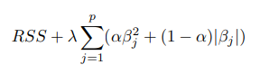
Regularization in linear models
Elastic net regularization
Elastic net is a combination of ridge and lasso regularization. It is most useful in situations with highly correlated features (multicollinearity).
Mathematically, the α regulates the ratio the influence of ridge and lasso regularization. If α is zero, lasso regularization is applied, and if α is one ridge regularization is applied.
Notes:
Elastic Net combines the strengths of both by allowing sparse models (feature selection) and still being able to handle correlated features.

Slide 10
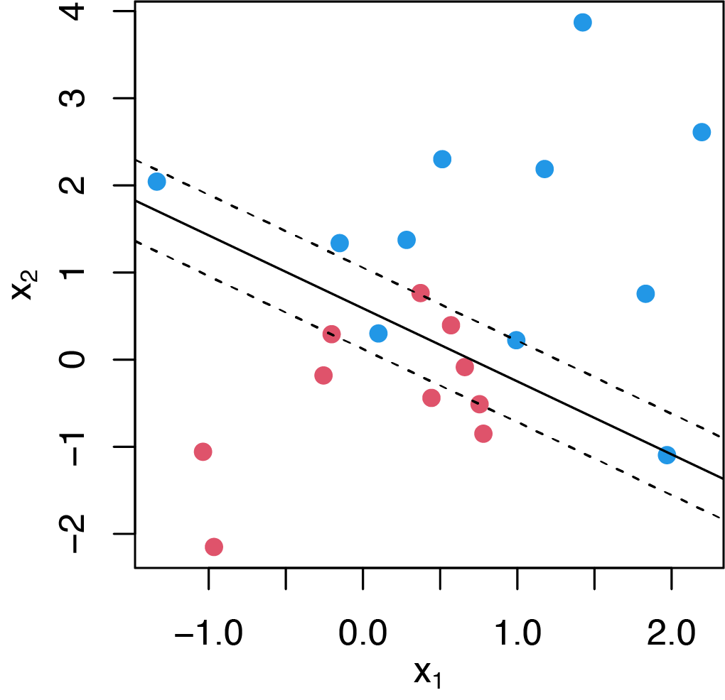
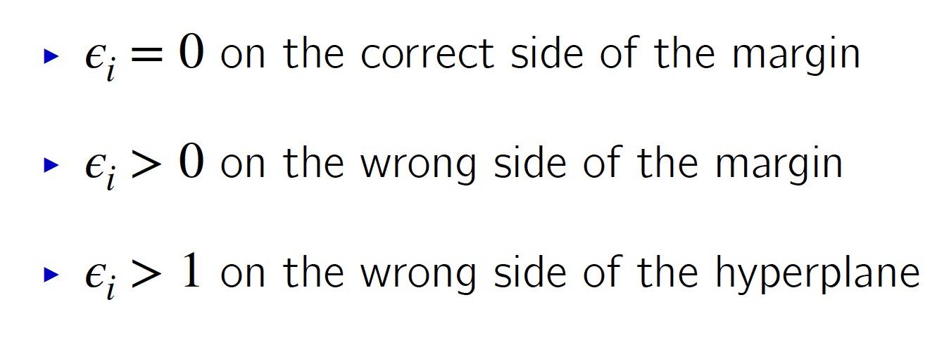
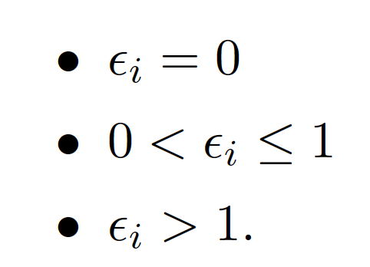
Support vector classifier (SVC

Slide 11
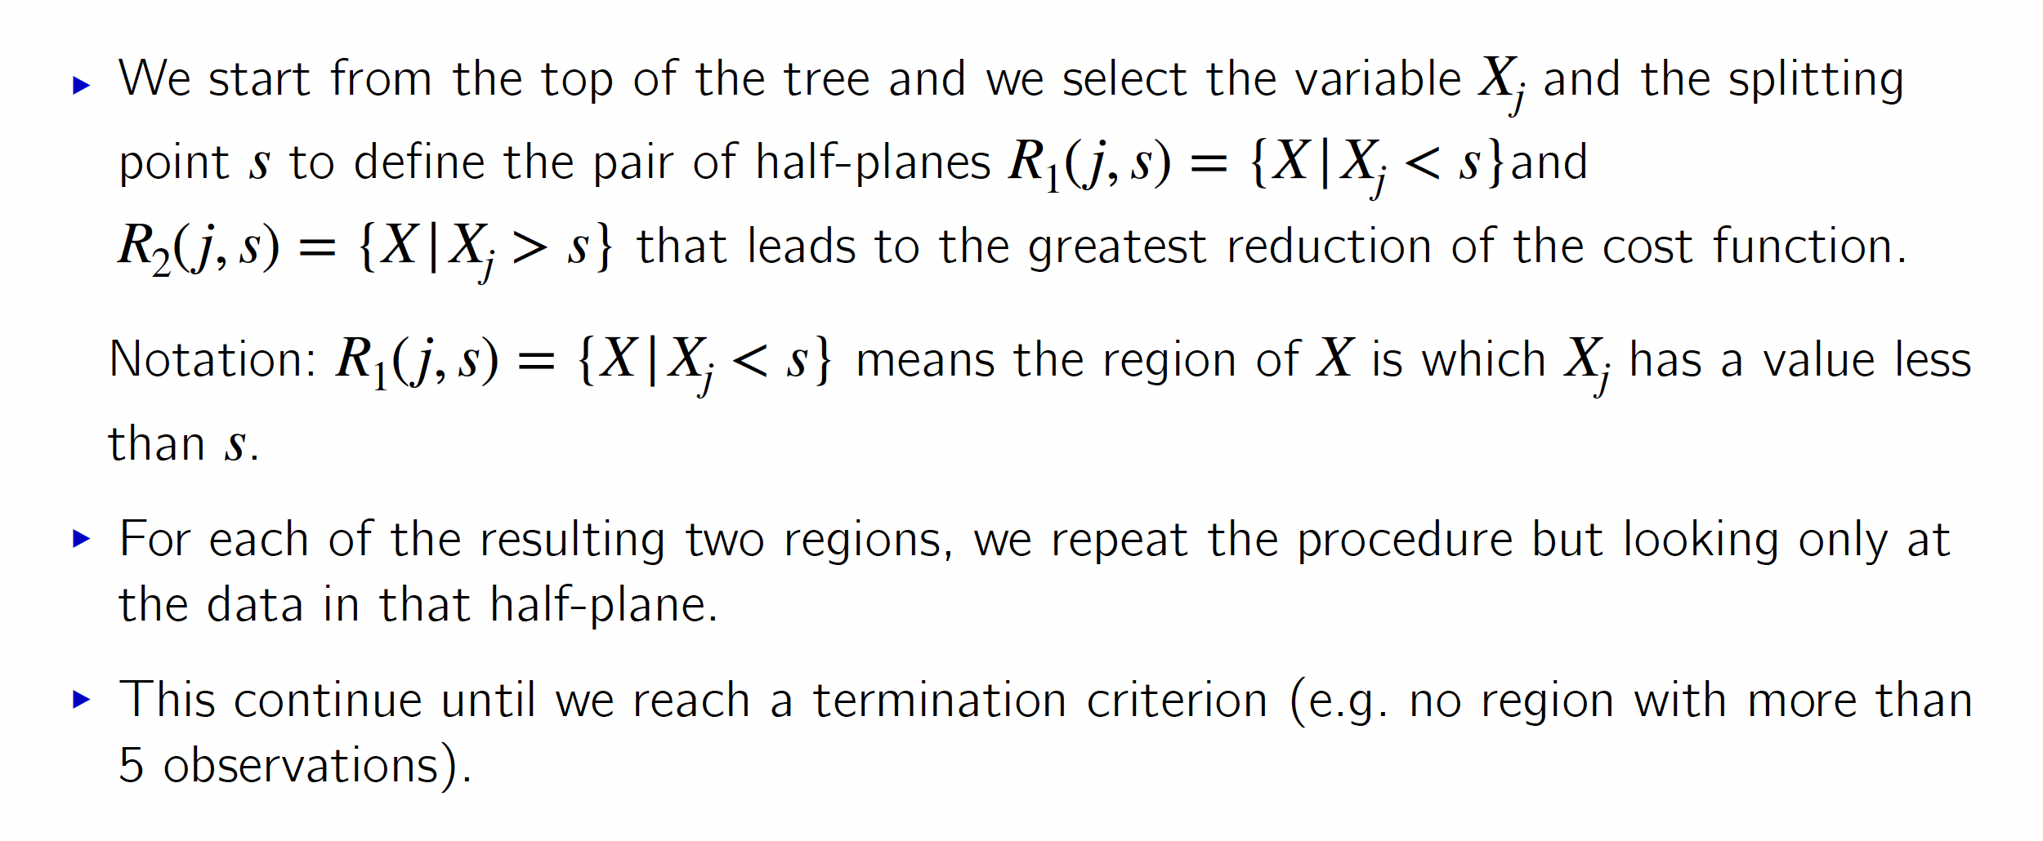
Tree-based methods
How a decision tree is constructed:

Slide 12
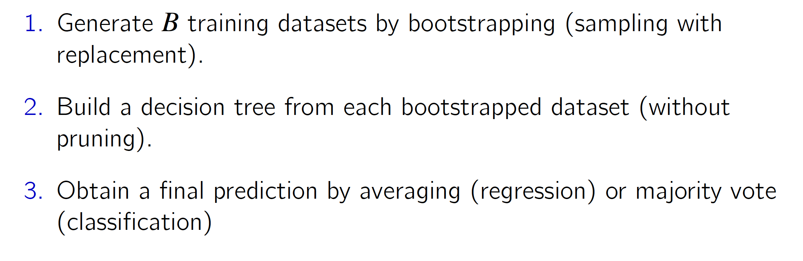
Tree-based methods
Bagging:
Bagging reduces the variance by averaging the predictions obtained by multiple independent trees. The independent trees are obtained by building several big trees (without pruning), each from a bootstrapped version of the dataset.

Slide 13
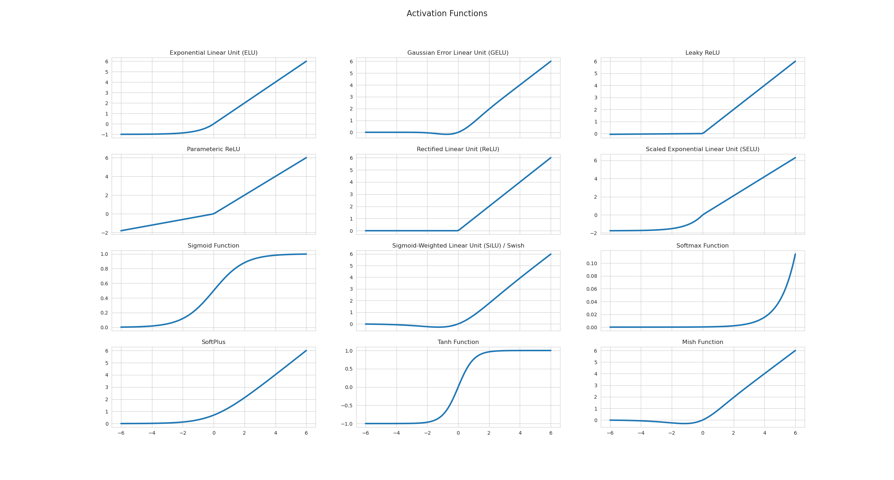
Activation functions in Neural Networks
Vanishing gradient problem
Dying ReLu

Slide 14
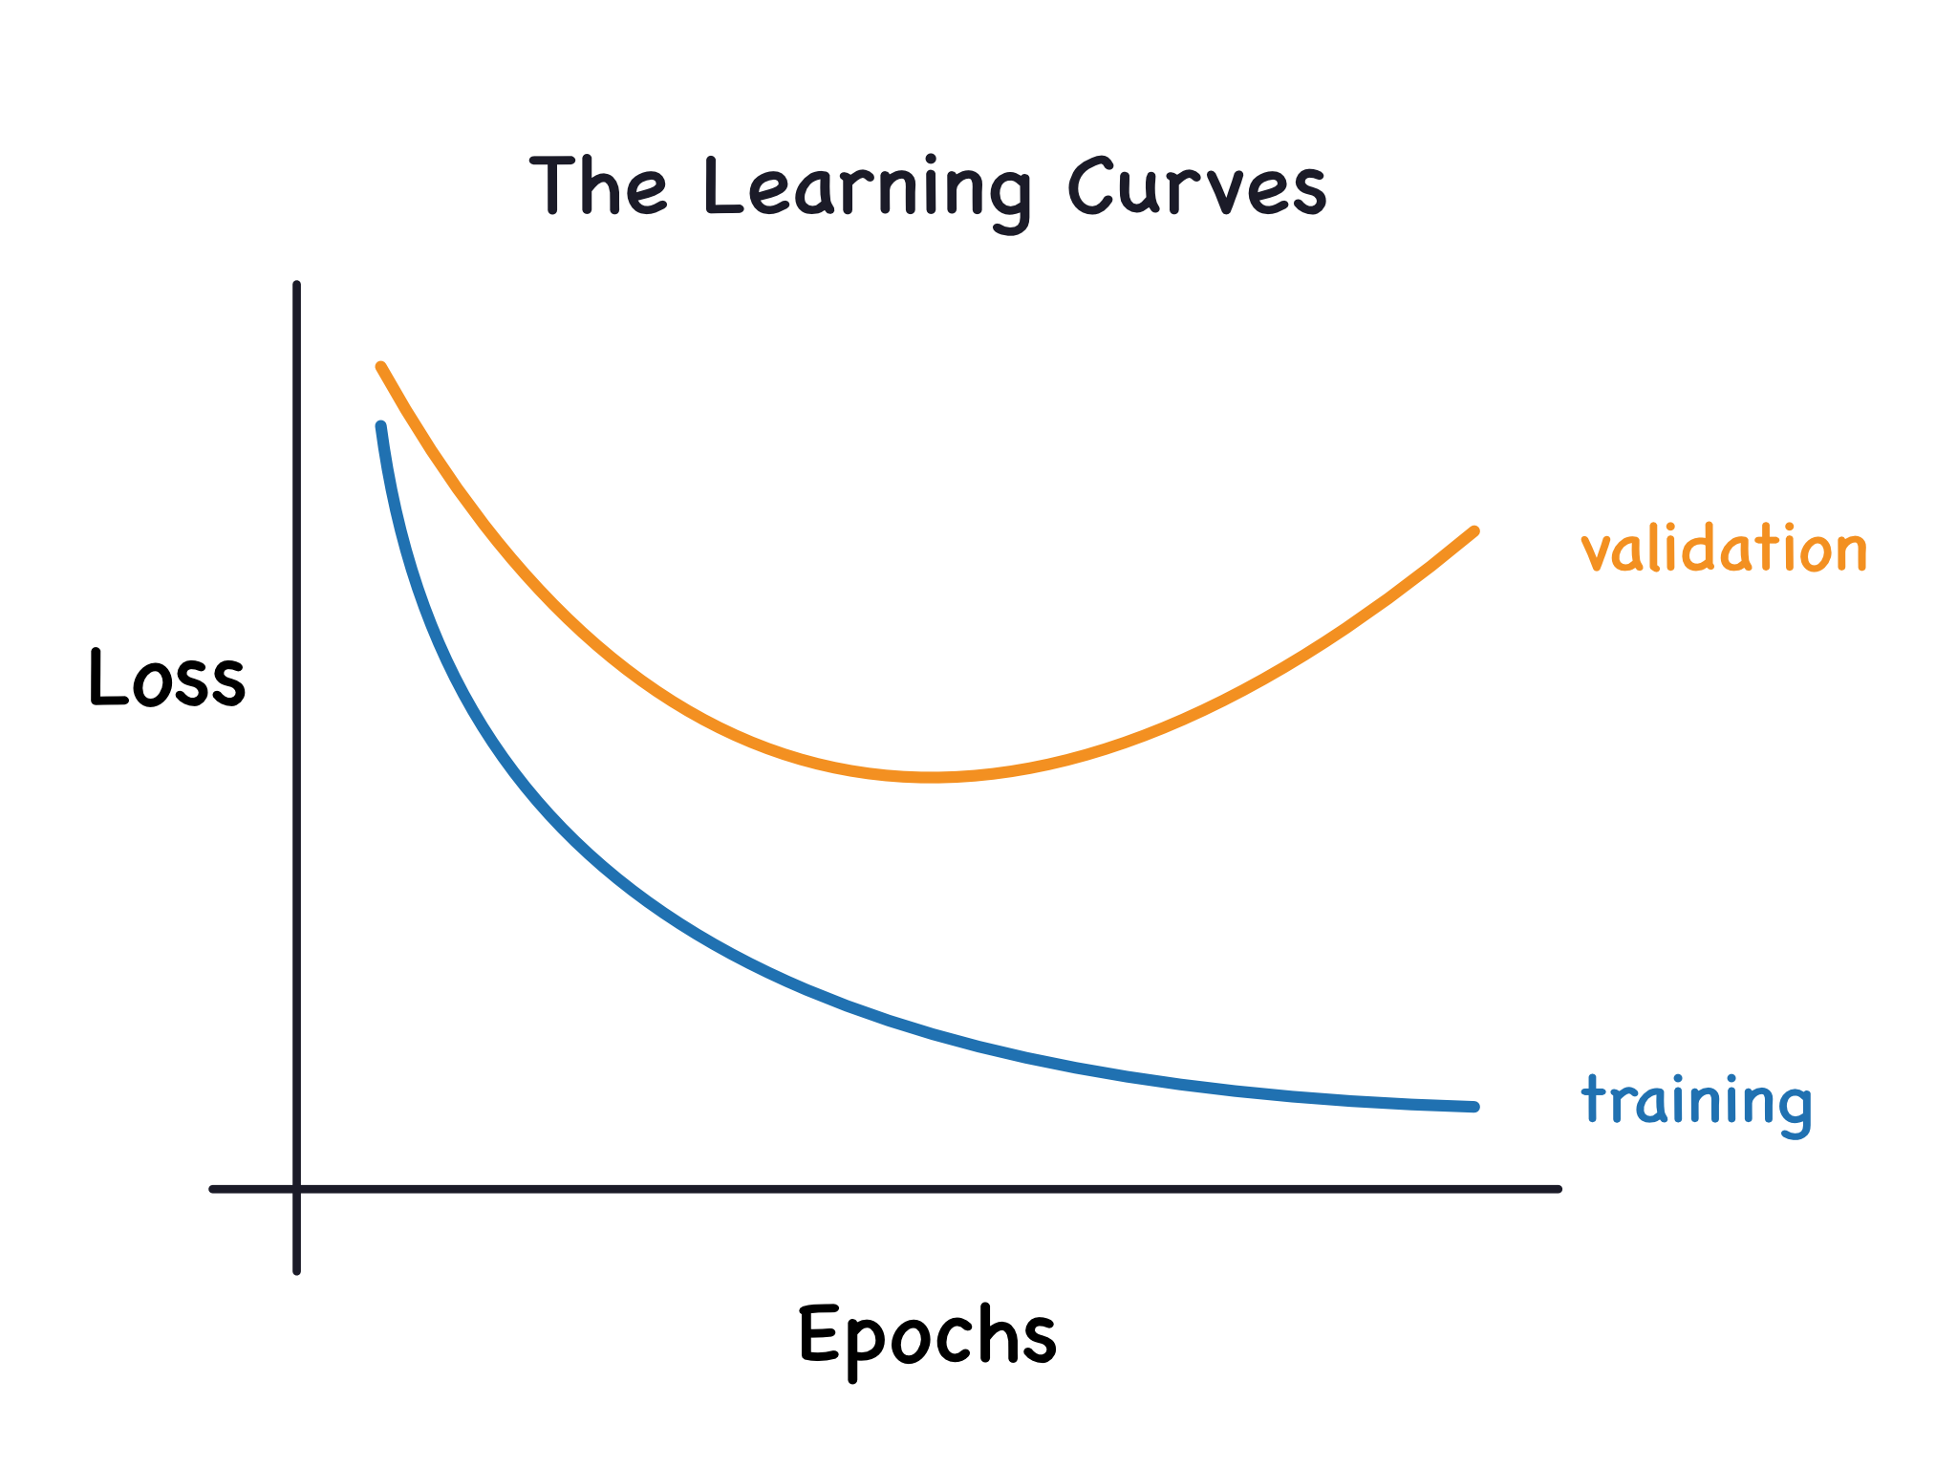
Regularization of a Neural Network
Observe that the Neural Network is clearly overfitting.
Explain what is happening
Come up with solutions (Add more data, simplify the Network, regularization, other {more advanced} techniques)

Slide 15
Regularization Techniques
Dropout
Batch normalization
L1 and L2
Early stopping

Slide 16
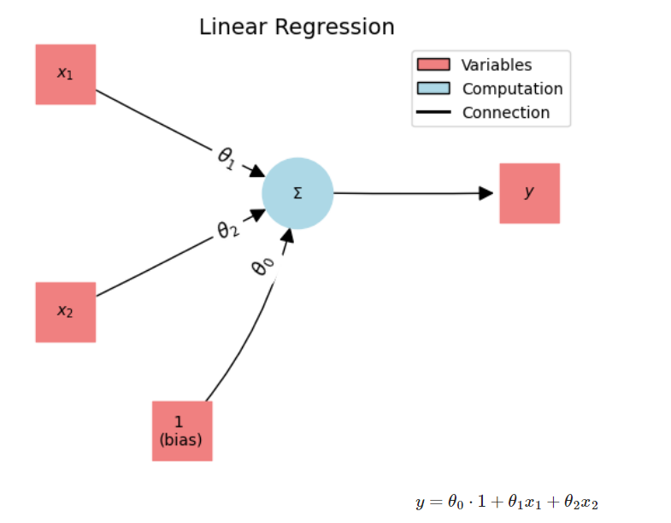
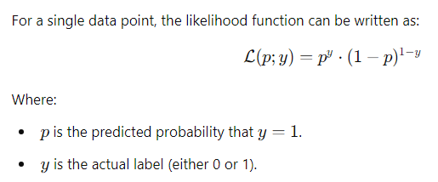
Neural Networks & Regression tasks
Regression problem → how to solve with NN?
Amount of input neurons & output neurons
Loss function?
Hidden layers necessary?
Activcation function necessary?
Draw / visualize diagram
Classification problem →change loss function? If so, which loss function?
Disadvantages manual feature engineering
Notes:
Time consuming and dependent on expert knowledge
Domain knowledge may be incomplete, missing valuable transformations
Capturing complex interactions is difficult with manual feature engineering

Slide 17
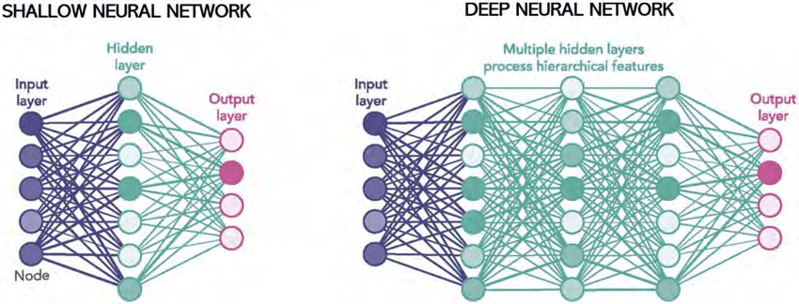
Depth and Width of Neural Network
Width & depth? Relation to capacity to fit the data?
Width = amount of neurons = amount of features (overfitting)
Depth = amount of layers (indirectly also neurons) = complexity of features (overfitting & vanishing / exploding gradients)
Advantages & disadvantages of shallow network vs deep network for regression
Training a network but we observe overfitting
What did we see?
How to mitigate this with width and depth of network?
Other strategies?
Notes:
Definition: Width refers to the number of neurons (or units) in a single layer of the neural network, particularly in the hidden layers.
Impact on capacity: Increasing the width of a neural network (i.e., having more neurons in a layer) allows the network to capture more complex patterns within each layer.
Wider networks can represent more fine-grained features from the input data, providing greater capacity to fit the training data.
However, making the network too wide can lead to overfitting, where the network memorizes the training data without generalizing well to unseen data.
Definition: Depth refers to the number of layers in the network, especially the number of hidden layers between the input and output layers.
Impact on capacity: Increasing the depth allows the network to learn hierarchical or more abstract representations of the data.
Each layer in a deep network extracts increasingly complex features, with lower layers capturing simpler patterns and higher layers capturing more abstract patterns.
A deeper network can solve more complex problems, but it also becomes harder to train due to issues like vanishing or exploding gradients. Depth also increases the risk of overfitting if not managed properly with techniques like regularization.
Shallow and Wide networks are simpler and faster to train, and may be well-suited for simpler problems or smaller datasets, but they struggle with complex data structures and require a larger number of neurons.Deep and Narrow networks excel at handling complex, large-scale data, providing a more efficient way to learn intricate patterns. However, they are harder to train and can overfit if not properly managed.
Other strategies: stop training earlier, data increasing, data augmentation,

Slide 18
Why is backpropagation efficient?
Makes use of chain rule to compute gradients. → possible to calculate gradient of loss function with respect to parameters of the model in one go.
This makes it unnecessary to recalculate intermediate results.

Slide 19
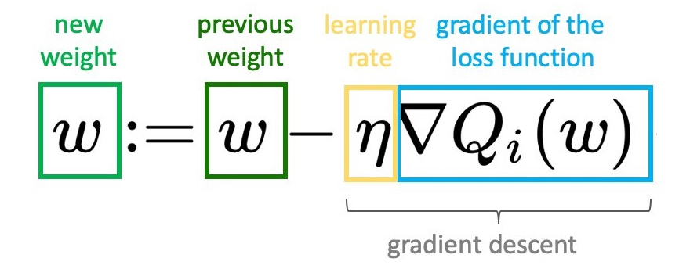
Relationship backpropagation & Gradient Descent
Backpropagation provides the gradients
Gradient descent uses these gradients to update weights of the model in direction that minimizes the loss.

Slide 20
“Vanishing gradients” & Batch Normalisation
In deep networks, derivates often shrink towards zero as the backpropagation algorithm moves back through the layers, leading to very small gradients. → weights in earlier layers are barely updates → layers not able to learn.
Batch normalisation standardizes inputs to each layer by making the mean=0 and sd=1. This reduces the chance of extermely high or low activations

Slide 21
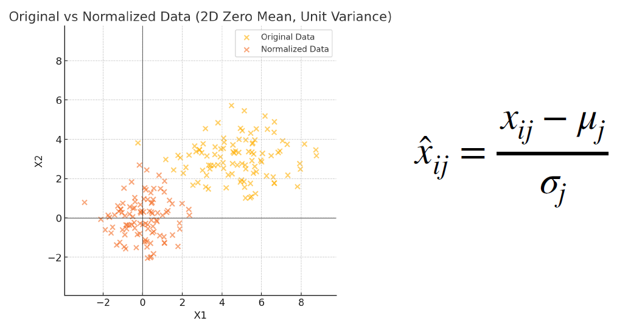

Slide 22
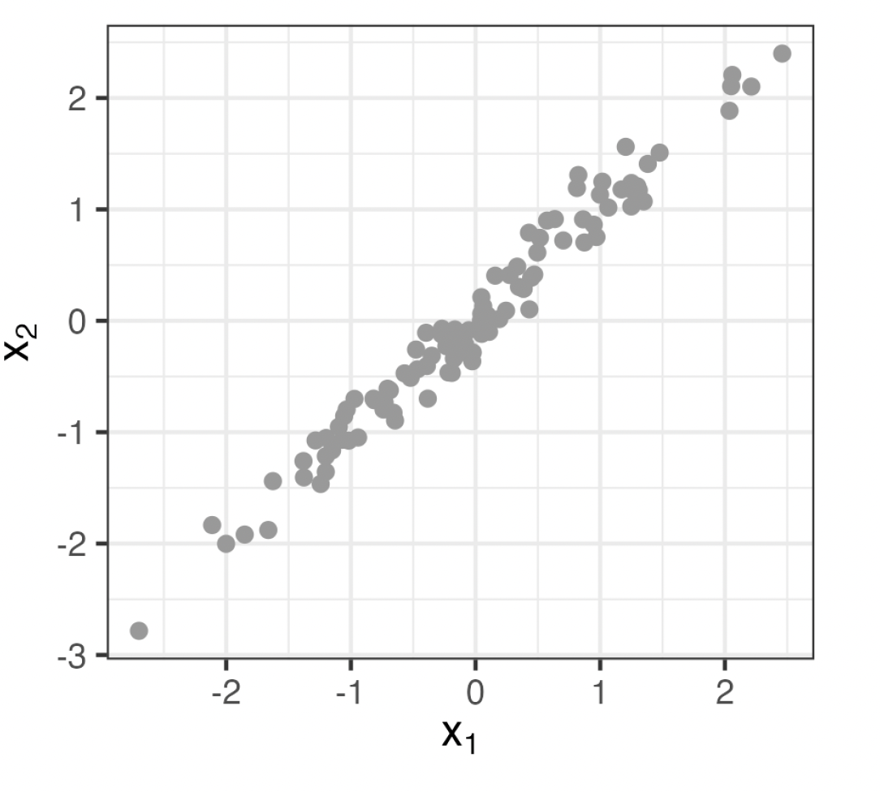
Principal component analysis (PCA)
PC2
PC1

Slide 23
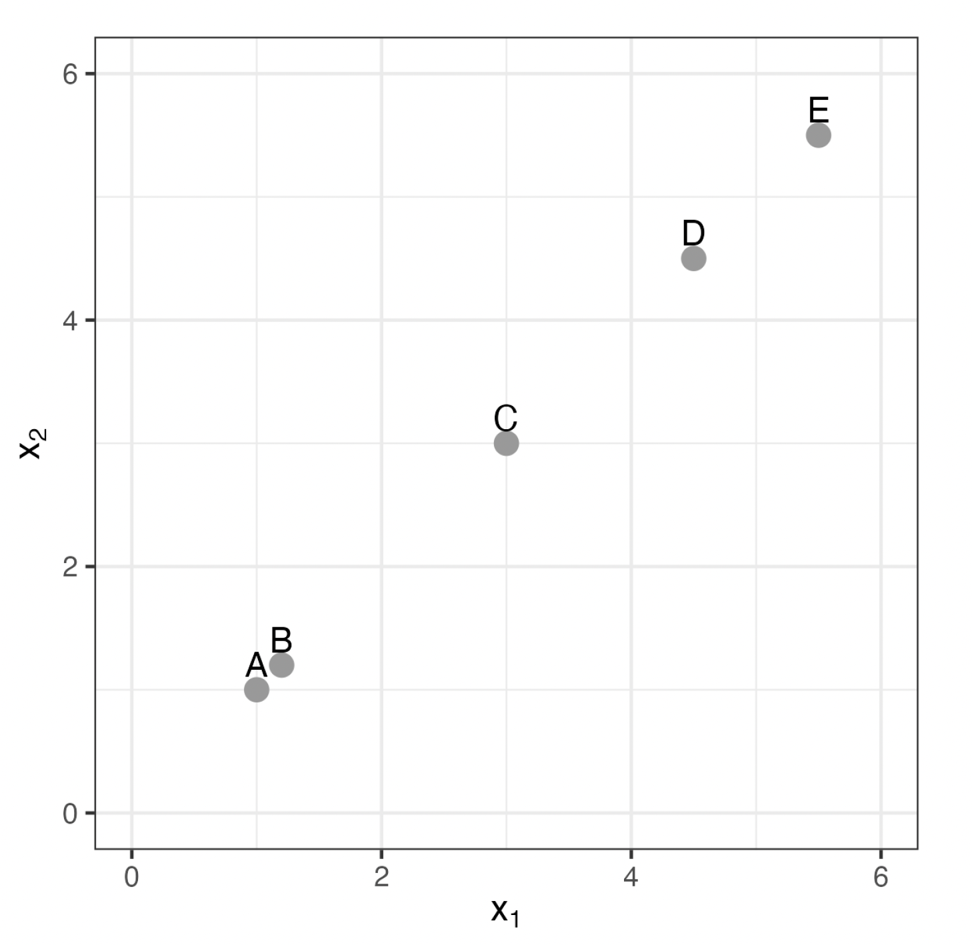
Hierarchical clustering

